Slide 1

IntoTheRabbitHole: A Web Application for Teaching Middle
School Students About Search Algorithms
Pragathi Durga Rajarajan, Dr. Fred Martin

Slide 2
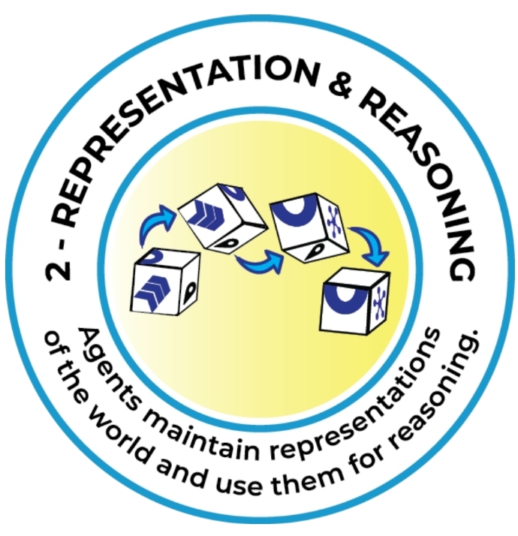
Background
K-12 AI literacy is increasingly important
Search algorithms education
Fundamental AI concept
Aligns with AI4K12’s Big Idea 2
Need for accessible, engaging, and interactive software tools
IntoTheRabbitHole
2
Pragathi Durga Rajarajan, Dr. Fred Martin

Slide 3

Research Questions
(RQ1) Can we develop an engaging and enjoyable web application to teach search algorithms?
(RQ2) Could we find evidence of student learning of Depth First Search and Breadth First Search from using our application?
(RQ3) How do students compare Depth First Search and Breadth First Search after interacting with IntoTheRabbitHole?
3
Pragathi Durga Rajarajan, Dr. Fred Martin

Slide 4
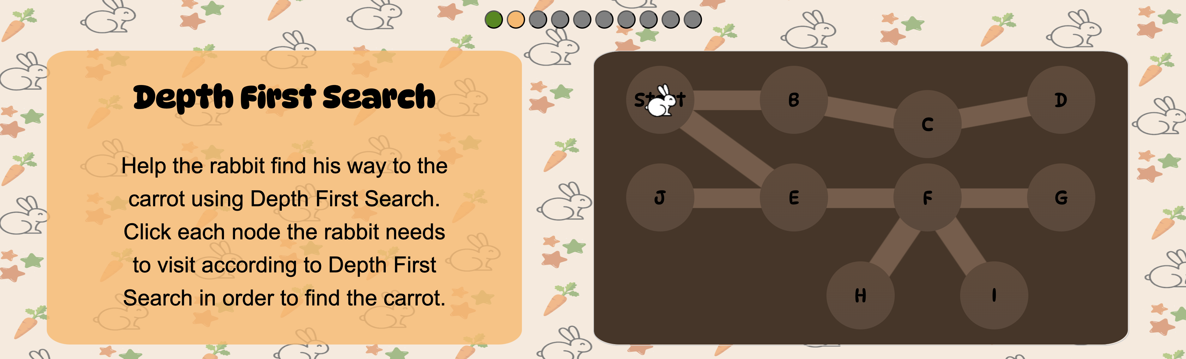
IntoTheRabbitHole Tool Design
User interface – IntoTheRabbitHole DFS Puzzle Training Level 1
4
Pragathi Durga Rajarajan, Dr. Fred Martin

Slide 5
Study Design
9 AI educational software tools were tested
Participants - middle school children
Location - STEM Public Charter School
Students rotated between the software tools every 8-10 minutes
Data collection
Collective pre-survey
IntoTheRabbitHole Website Interaction Data
Audio/Screen Activity
Post-survey
6
Pragathi Durga Rajarajan, Dr. Fred Martin

Slide 6
Results – (RQ1) Can we develop an engaging and enjoyable web application to teach search algorithms?
Observations
Many students enjoyed the timed challenge level and competed to get the highest score
Some students engaged in discussions on whether DFS or BFS would be more helpful for a lost person
Rating | Count of Students
1 | 2
2 | 2
3 | 11
4 | 18
5 | 14
On a scale from 1 (least fun) to 5 (most fun), how students rated IntoTheRabbitHole
11
Pragathi Durga Rajarajan, Dr. Fred Martin

Slide 7
Results – (RQ2a) Could we find evidence of student learning of Depth First Search and Breadth First Search from using our application?
7
Pragathi Durga Rajarajan, Dr. Fred Martin

Slide 8
Results – (RQ2a) Could we find evidence of student learning of Depth First Search and Breadth First Search from using our application?
Answer | Pre-survey | Post-survey
Correct | 14 | 33
Incorrect | 32 | 13
No Response | 3 | 3
McNemar’s Test
p-value = 0.001315
effect size = 23 / 5 = 4.6
Statistically significant difference in proportion of correct answers between the pre-survey and post-survey
Results on DFS traversal item on both the pre-survey and post-survey.
8
Pragathi Durga Rajarajan, Dr. Fred Martin

Slide 9
Results – (RQ2b) Could we find evidence of student learning of Depth First Search and Breadth First Search from using our application?
Answer | Post-survey
Correct | 26
Incorrect | 21
No Response | 2
Performance on post-survey BFS traversal item
9
Pragathi Durga Rajarajan, Dr. Fred Martin
Notes:
There was no pre vs post comparison for BFS due to limits on the length of the combined presurvey

Slide 10
Results – (RQ3) How do students compare DFS and BFS after interacting with IntoTheRabbitHole?
Response to Post-survey Multiple Choice Item Comparing DFS and BFS | No. | Sample Open-Ended Response Explaining Their Selection
It depends on the graph/tunnel system and the location of the goal | 21 | If the path is small, DFS is faster due to it being able to check every corner in the map at a decently fast pace, but if the maze is big, BFS is faster due to the processes ability to multi-task.
They are both equally fast | 7 | They both complete an equal amount of ground
DFS is always faster | 14 | DFS focuses on one area at a time, meanwhile, BFS kept backtracking.
BFS is always faster | 4 | I believe BFS is faster because you get to check every path efficiently
No Response | 3
Responses on post-survey DFS vs BFS multiple choice item and open-ended explanations.
10
Pragathi Durga Rajarajan, Dr. Fred Martin

Slide 11

Discussion
Successful aspects of IntoTheRabbitHole: Interactivity, challenge level, structured guidance
Web-based application → accessible and easy to use
Students better understood DFS
IntoTheRabbitHole is an effective, quick introduction to DFS and BFS
Students spent an average of 4.82 mins with IntoTheRabbitHole
12
Pragathi Durga Rajarajan, Dr. Fred Martin

Slide 12

Limitations and Future Work
Canonical DFS and BFS were not shown
Limited sample size
Show graphs of varying sizes
Introduce canonical DFS and BFS
Incorporate pre-survey vs post-survey analysis of BFS as well
13
Pragathi Durga Rajarajan, Dr. Fred Martin

Slide 13
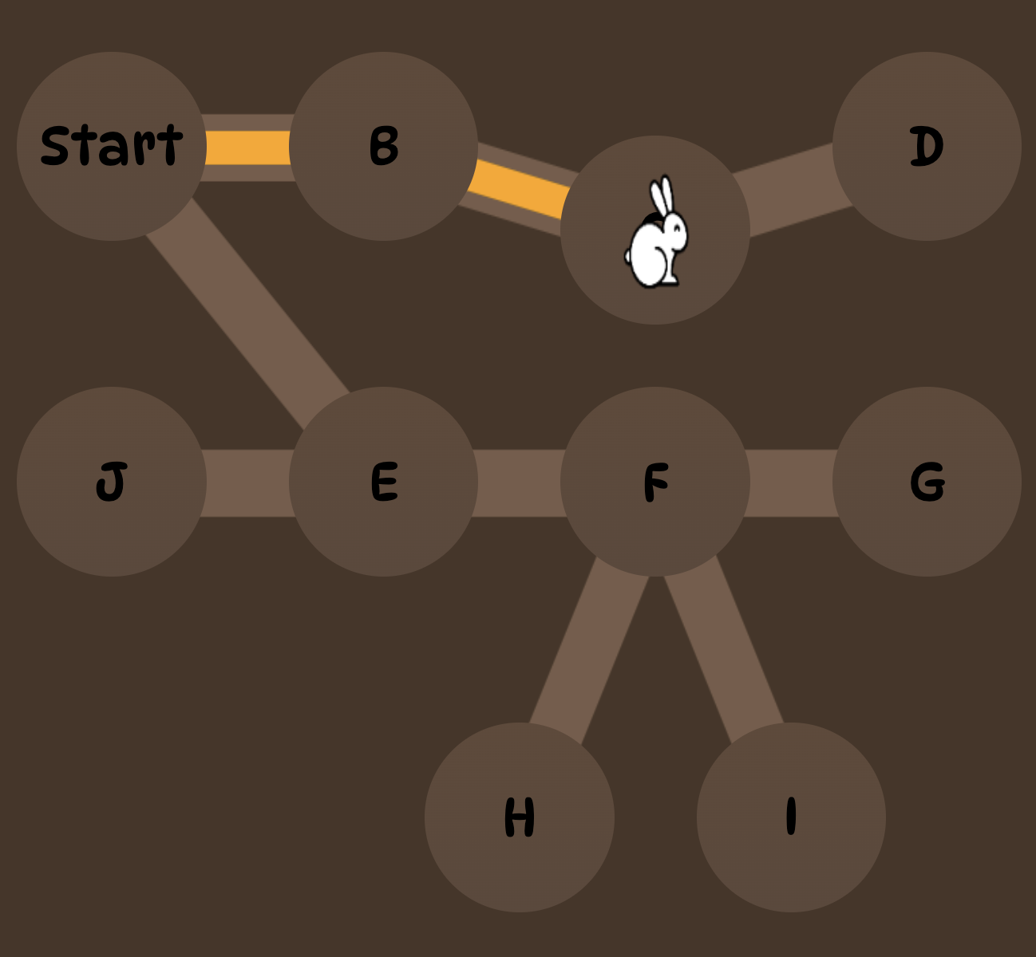
Conclusion
IntoTheRabbitHole - interactive web application for teaching DFS and BFS
Evaluated with middle school students
IntoTheRabbitHole was effective
Especially for DFS
Demonstrated the potential of interactive software tools for AI education
14
Pragathi Durga Rajarajan, Dr. Fred Martin
Notes:
Student performance on DFS puzzles in the application was higher than that of BFS

Slide 14
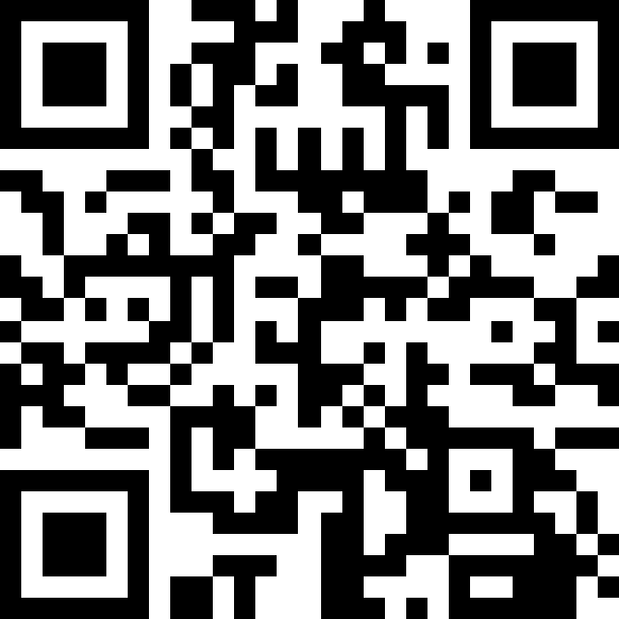
Questions?
Access a repository containing the links to the IntoTheRabbitHole live deployed version, GitHub repository, and this presentation here.
Acknowledgments
We are grateful to Dr. Deepti Tagare, Dr. Ismaila Sanusi, and our peers in the University of Texas at San Antonio’s research course Developing AI Tools for K-12 for their feedback and support
We would like to thank the administrators and staff who made the after-school sessions possible. We also thank the students who participated in the study
This material is based upon work supported in part by the National Science Foundation under Grant IIS-2112633. Any opinions, findings, and conclusions or recommendations expressed in this material are those of the author(s) and do not necessarily reflect the views of the National Science Foundation.
15
Pragathi Durga Rajarajan, Dr. Fred Martin

